Slide 1
Australian Sailing Performance Pathways Strategy Update
‘Planning to be the best HP development program in the World by Paris 2024’

Slide 2
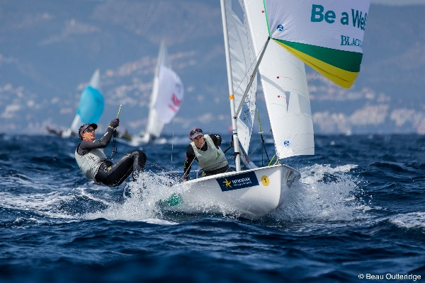
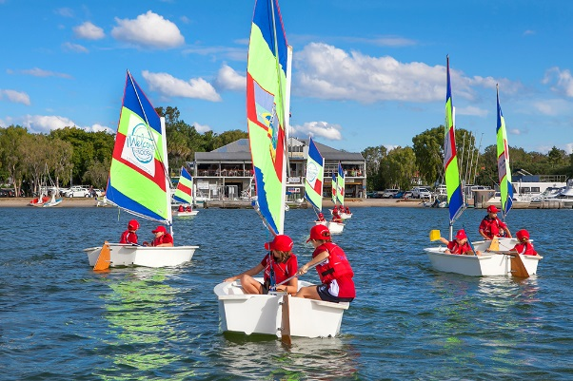
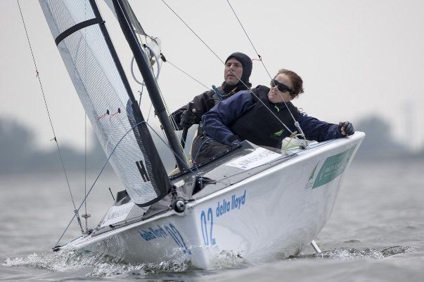
Performance Pathways Strategy Overview
Context – Where we sit
Alignment to HP strategy
Performance Pathways 2021-22
Key Changes
Categorisation and selection
What will you see

Slide 3
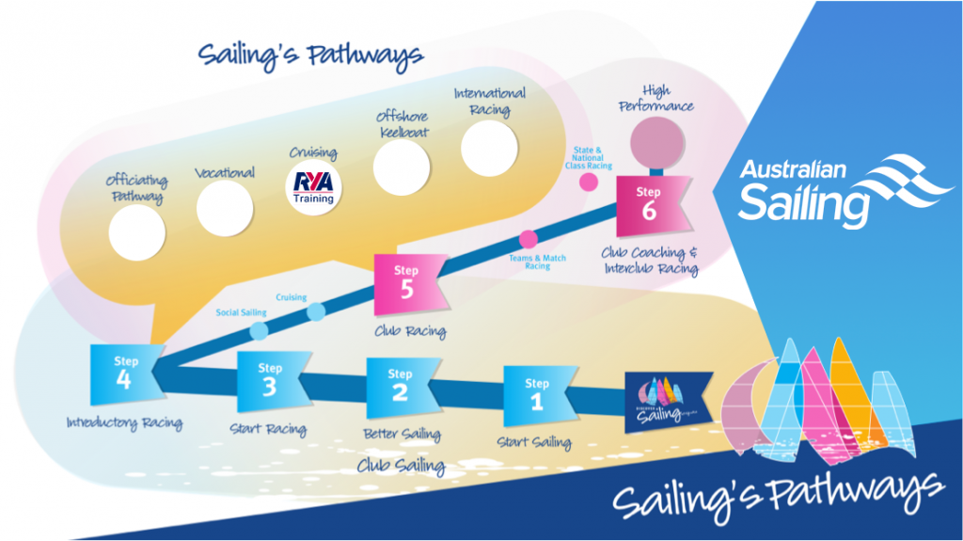
Performance Pathways - Context
Where Performance Pathways sit

Slide 4
Performance Pathways – Alignment to Strategy

Slide 5
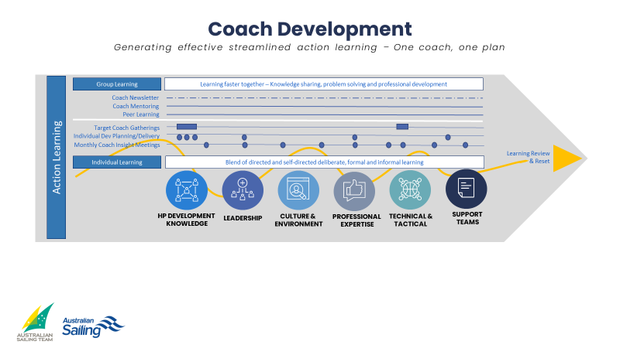
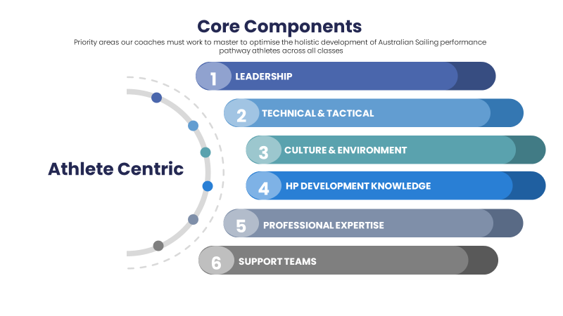
Performance Pathways – 2021/22
Athlete Development Framework
Coach Development Framework and Programs
Enhanced
Daily Training Environments
Performance Support
Enhanced Integration (Internal and across
performance support)
New Classes additional support
Intro and development of Futures Program
Other Projects: Talent ID, AIS Coach/Staff Development etc.

Slide 6
Key Areas of Change
Coaching
Support for aspiring coaches
Advanced Fleet Coaches, state clinics professional development and mentoring
#Nextlevel Coach Program
Coach Advance Program and Individual Development Plans (IDPs)
System
IDPs aligned to Athlete Development Framework (ADF)
More informed athlete selection processes
Increased pathway visibility
Greater system alignment
Programs
Focused attendance at Youth Class Worlds instead of World Sailing Youth Worlds, for more effective development of young sailors – bigger fleets, more athletes, better quality coaching
Enhanced Youth/pre-emerging opportunities – state clinics plus invite based integration opportunities, #nextgen
Enhanced state programs with additional embedded performance support
Enhanced Futures program – supporting coaching at targeted international events, campaign plan development and support for identified athletes in Olympic classes

Slide 7
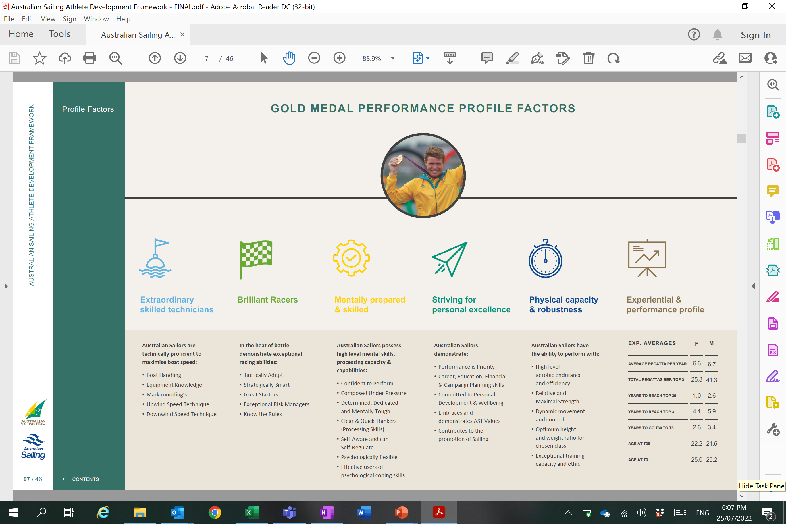
What we are looking for
Skilled
Sailors
Good
Racers
Committed to
developing
Squad minded
Physically/Mentally
Capable
Curious
Learners

Slide 8
Next steps – Youth Teams/Selection and Support
Performance Pathways group convene to ensure we maximise the youth class worlds experience
Work with class associations to understand the most effective structure, support and numbers of boats etc.
Generate clarity on how boats are to be selected and what those boats then access as part of our support
Create a clear calendar to better enable sailors, coaches and parents plan for the upcoming events and seasons

Slide 9
What people will see
Continued Presence at
Events
Sailor
Invitational Camps
Transition to PP
Coach Development
What to look for
What to coach
How to coach it
How to observe it
How to flag it
Youth Sails
State Champs
Sail Brisbane, Sydney and Melbourne
Other identified Regattas
State programs invite young sailors to camps to support development and talent ID
State programs integrate young sailors that are ready into relevant state sessions
#nextgen – new classes and female specific
Young sailors with identified and confirmed potential invited to be state:
Pre-emerging selection (previously ‘training partners’)
Scholarship athlete
3
4
1
2

Slide 10
AIS Categorisation

Slide 11
Selection Snapshot 2022 – State Programs (SSPP)
To be considered for selection | Overall Male/Mixed Sailors | Overall Female Sailors
Selection to the Australian Sailing Youth Team (1) and/ or top 3 placing and top 20% of the fleet for Youth Class Pathway Class Nationals U19 (4) | ✓ | ✓
Top 10 overall placing and top 20% of the fleet based on World Sailing Youth Categories Class World Championships (2) | ✓ | ✓
Top 10 overall placing and top 20% of the overall fleet at World Sailing Youth World Championships (3&4) | ✓ | ✓
Sail Sydney and Sail Melbourne which will include placing, fleet size and depth of field into consideration | ✓ | ✓
Top 10 (single handed) or top 6 (double handed) placing and top 30% of fleet at Australian Olympic Class Championship (4) | ✓ | ✓
Top 10 (single handed) or top 6 (double handed) overall placing and top 30% of the fleet at Olympic Class Junior World Championships and/or European Championships (5) | ✓ | ✓

Slide 12
Selection Snapshot 2022 – Futures
To be considered for selection | Overall Male/Mixed Sailors | Overall Female Sailors
Top 30% of the overall fleet at the Junior Worlds “U21 – U23” | ✓ | ✓
Top 50% of the overall fleet at the Olympic - Class Worlds | ✓ | ✓
Top 40% of the overall fleet at the Open Europeans | ✓ | ✓
Sail Sydney and Sail Melbourne which will include placing, fleet size and depth of field into consideration | ✓ | ✓
Top 8 (single-handed) or Top 6 (double-handed) overall AND top 20% fleet at Olympic Class Nationals (10 entries minimum) | ✓ | ✓
Youth Pathway Classes. Top 3 overall placing and top 20% of the fleet based at Class Nationals. (10 entries minimum) | ✓ | ✓
Youth Pathway Classes. Top 10 overall placing and top 20% of the fleet based on World sailing Youth Categories Class World Championships. | ✓ | ✓

Slide 13
What people will see
Increased opportunities for more developing sailors
Targeted competition entry and support plus a squad approach
Enhanced alignment along the pathway
More systematic ID and development practices
Enhanced coaching
Notes:
This approach is seamlessly aligned to the HP strategy through the:
Implementation of the AS squad-based approach earlier in the pathway to develop and enhance this cultural norm
Deliberate focus on competing within larger competitive fleets in developing ‘brilliant racers'
Enhancement of regatta coaching solutions
Progressive approach to domestic and international competition exposure, particularly in Europe
Better retention of sailors, by removing the constraint of one boat per nation
Broadening of selection windows that allow for greater observations over time versus the restriction of team size coupled with performance at only one event
Effective use of AS Performance Pathways resources

Slide 14
Thank you

Slide 15
For any additional questions contact any of the performance pathways team. Ken Lynch ken.lynch@sailing.org.au

